Slide 1




Helwan University
Faculty of Computers and Artificial Intelligence
EduGuard: Smart Learning Management System with Cheating Detection in Quizzes
Graduation Project Presentation – 2025
14 Jun, 2025
1

Slide 2


Agenda Overview
01
Problem Statement
07
Face Recognition Model
02
Why EduGuard Matters
08
Head Pose Estimation Model
03
Objectives of EduGuard
09
Gaze Pose Estimation Model
04
Competitors
10
Object Detection Model
05
Diagrams
11
Implementation
06
Face Detection Model
2

Slide 3
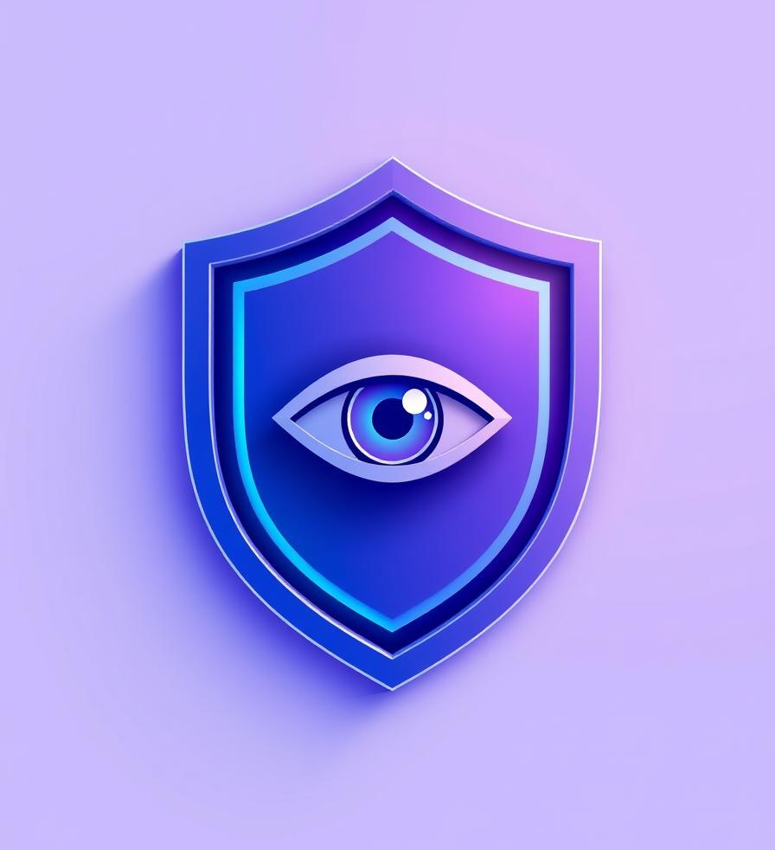
Abstract
EduGuard is a smart e-learning monitoring and management system.
Solves online exam cheating with real-time AI-based proctoring.
Uses face recognition, face detection, object detection, head pose, and eye tracking.
Built using React.js, Laravel (PHP), FastAPI, MySQL, TensorFlow, and OpenCV.
Ensures fairness, academic integrity, and offers full LMS functionality.
3

Slide 4



Problem Statement
With the rapid shift towards online education—accelerated by the COVID-19 pandemic—many educational institutions adopted digital platforms for learning and assessment. However, despite their widespread use, current e-learning systems present several critical challenges that undermine the quality and integrity of remote education.
Cheating in Online Exams:
Lack of monitoring in tools like Google Forms and quiz modules.
Students can use unauthorized devices, search the internet, or collaborate via messaging apps.
Undermines academic integrity, leading to canceled quizzes, unfair grading, and reputational damage.
Limited Interactivity
Students often struggle to access course materials, as slides and lectures are not centralized in one platform.
Instructors usually share content through WhatsApp groups or Google Drive, leading to disorganization and scattered resources..
4

Slide 5


Why EduGuard Matters
Academic Integrity: AI-driven monitoring (facial recognition, object detection, facial detection, head pose, and eye tracking) prevents cheating, ensuring fair assessments.
Unified Platform: Combines learning and proctoring, simplifying user experience and boosting productivity.
Accessibility & Flexibility: Supports inclusive education, enabling learning from anywhere.
Enhanced Engagement: User-friendly interface improves student involvement and instructor efficiency.
Modern Education: Leverages AI and web technologies to set a model for future e-learning systems.
Focus on university educators and students: EduGuard is designed specifically to meet the needs of higher education professionals and learners.
5

Slide 6

Objectives of EduGuard
01
Enhance interactivity with dynamic course content and quizzes.
02
Ensure integrity using AI for face detection, object detection, gaze tracking (Eye movements), and head pose.
03
Provide real-time monitoring and automated alerts for suspicious activity.
04
Implement secure, role-based access for students, instructors, and admins.
05
Centralized course management for seamless navigation.
06
Improve learning outcomes with reliable assessments.
6

Slide 7
Competitors Overview
ProctorU | Live & AI proctoring, facial recognition, gaze tracking | $17.50-$51.25/test
Honorlock | AI voice detection, BrowserGuard, LMS integration | $5-$15.50/test
Examity | Live & automated proctoring, AI flagging, LMS dashboards | $10-$25/test
Moodle | Open-source LMS, no AI or proctoring | Free
Competitors offer various proctoring solutions, ranging from live to AI-driven. Moodle remains a free, open-source LMS without integrated proctoring features
7

Slide 8
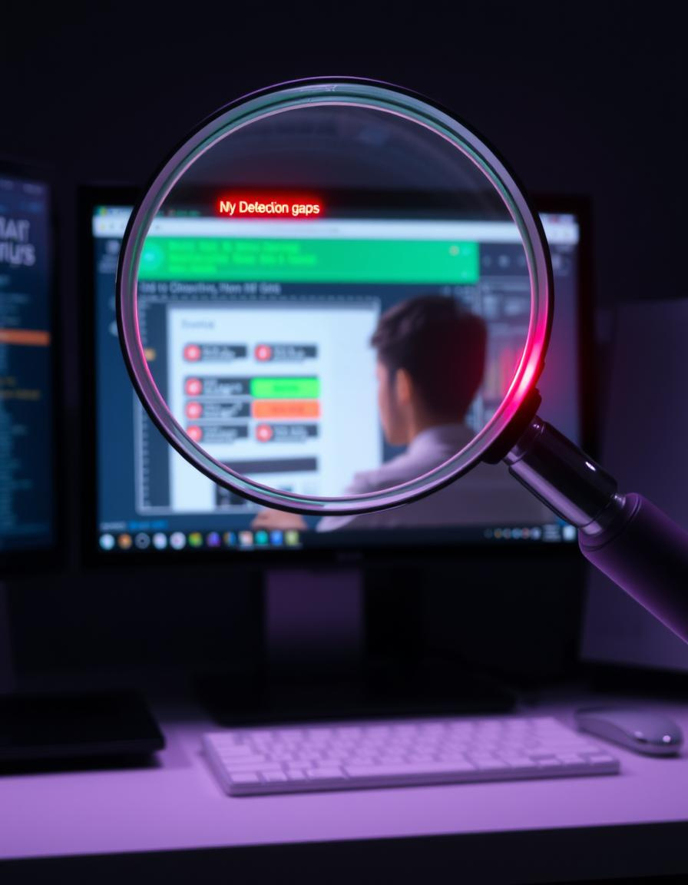




Existing Cheating Detection Gaps
Limited Real-time
Some platforms lack effective live surveillance, allowing cheating to go undetected during exams.
Human Over-reliance
Excessive dependence on human proctors or manual review increases cost and decreases scalability.
Inconsistent Flagging
Detection tools often suffer from false positives or negatives, leading to unreliable outcomes.
Not All-in-One Education Platform
Many systems do not combine LMS, AI proctoring, and instructor control, causing fragmented user experiences.
8

Slide 9
Feature Comparison Table
9
Feature | ProctorU | Honorlock | Examity | EduGuard
Face Detection | ✅ | ✅ | ✅ | ✅
Face Recognition Login | ⚠️ Manual ID check | ✅ | ⚠️ Manual ID check | ✅ AI model w/ embeddings
Eye / Gaze Tracking | ✅ | ❌ | ❌ | ✅
Head Pose Estimation | ❌ | ❌ | ❌ | ✅
Object Detection | ✅ | ✅ | ✅ | ✅
Cheating Score System | ❌ | ❌ | ❌ | ✅ Real-time score + auto-block
Auto Quiz Termination | ❌ | ❌ | ❌ | ✅ At score = 100
Real-Time Monitoring | ⚠️ Limited – human proctors only. | ✅ Yes – via AI + recording. | ✅ Yes – hybrid model. | ✅ Yes – full ML live analysis.
LMS Integration | ⚠️ Separate | ✅ Integrated | ✅ Integrated | ✅ Built-in LMS

Slide 10


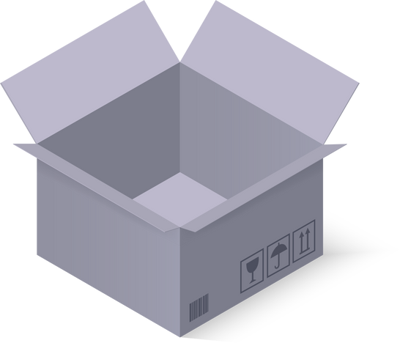

EduGuard's Advanced Cheating Detection
Face Recognition Login
Matches real-time webcam images to 50 pre-registered embeddings. Denies access if there is no match.
Real-time Monitoring
Face detection ensures continuous presence. Eye and head pose tracking detect suspicious glances or movements.
Unauthorized Object Detection
Flags prohibited items like phones, books, or additional people. This enhances security against external aids.
Automated Scoring & Response
Each suspicious action increases a "cheating score." If it reaches 100, the quiz automatically closes, and the student receives a zero. All flagged images are saved for instructor review.
10

Slide 11
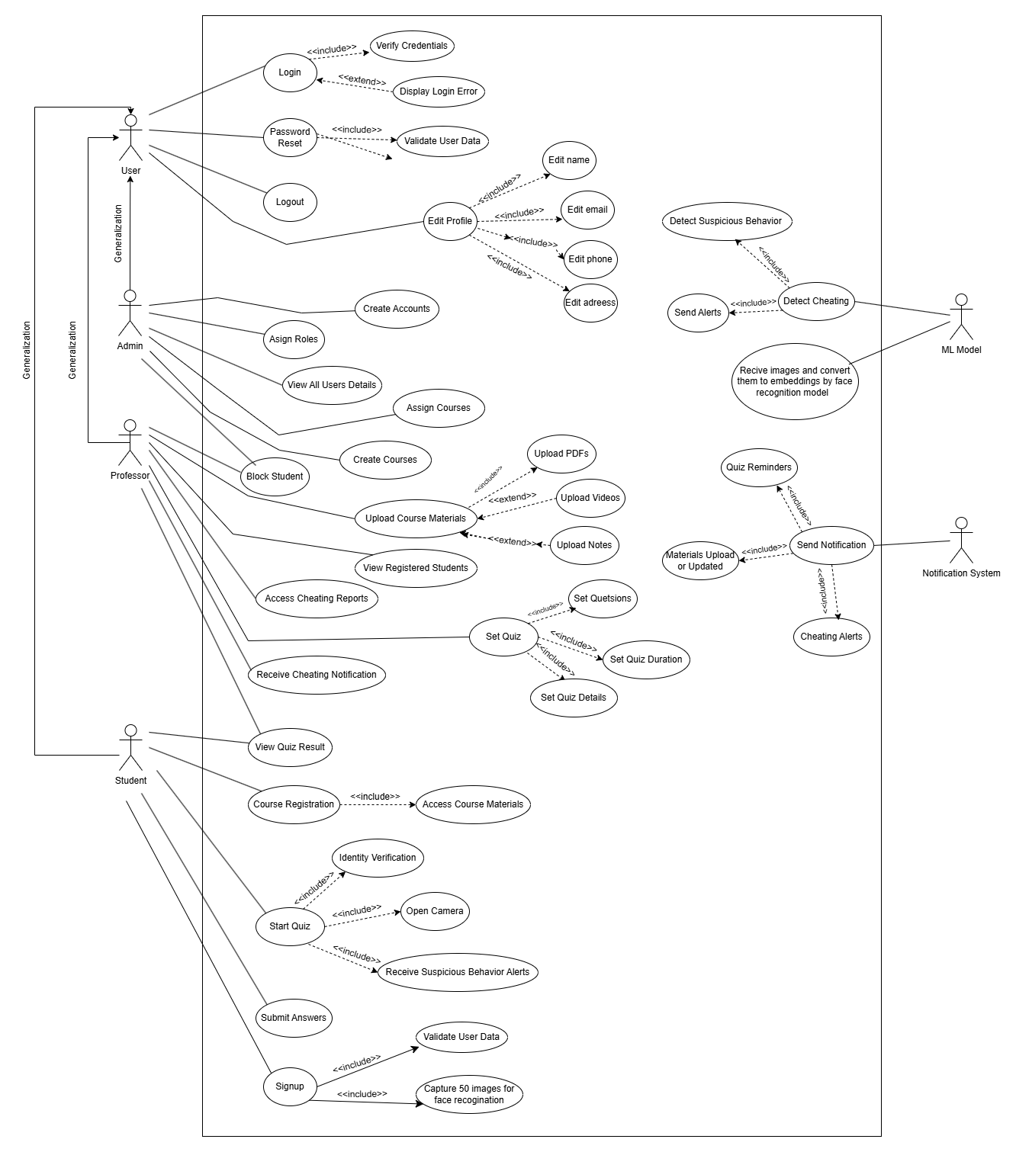
Use-Case Diagram
11

Slide 12
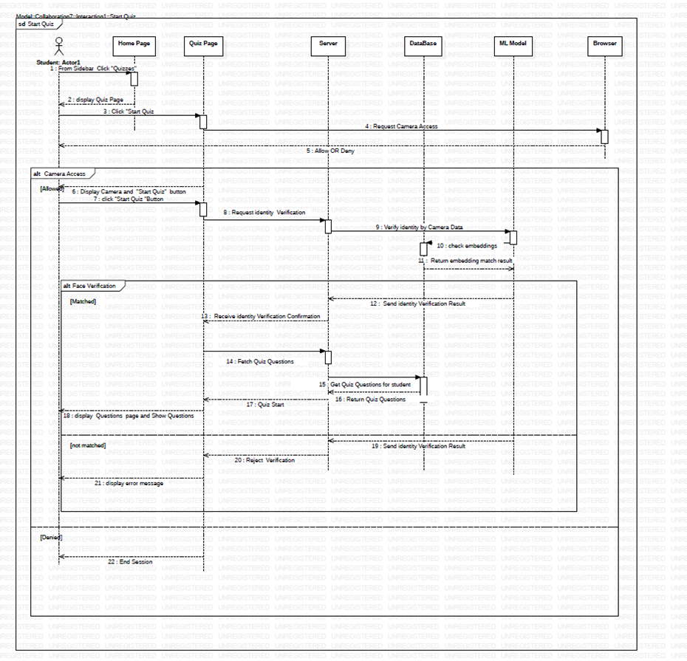
Sequence Diagram for Start Quiz
12

Slide 13
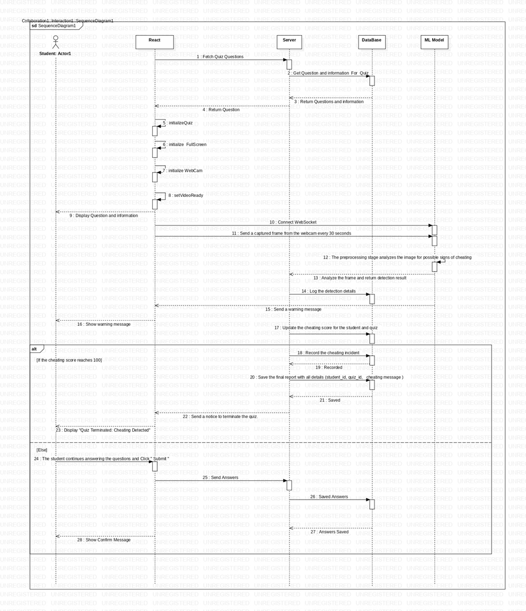
Sequence Diagram During The Quiz
13

Slide 14
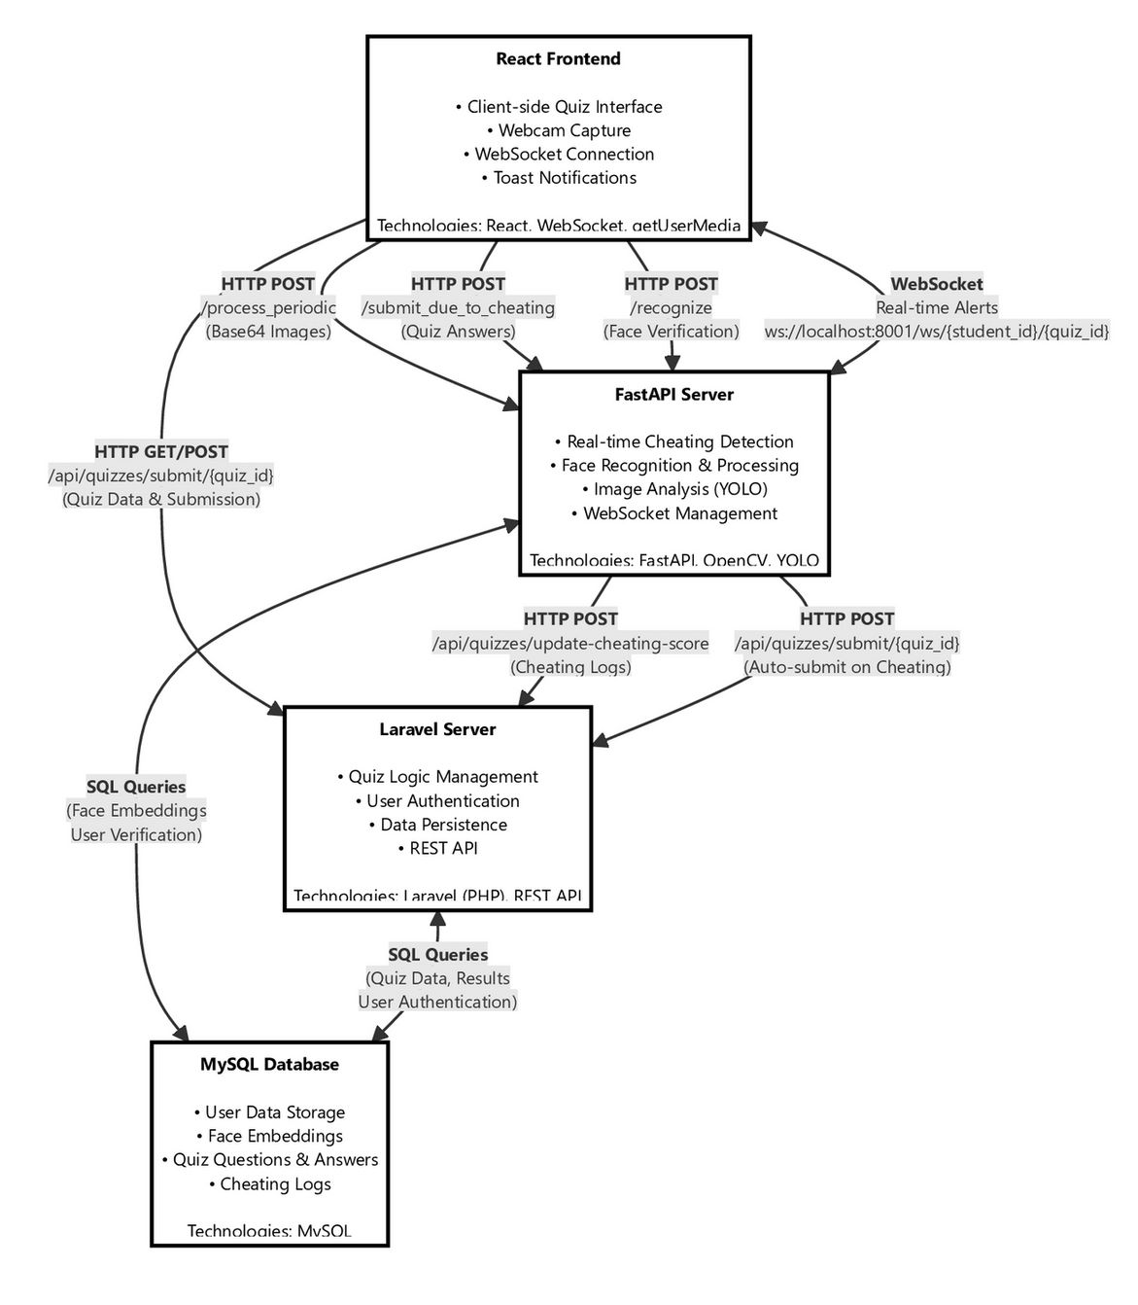
Quiz Anti-Cheating System Architecture
14

Slide 15
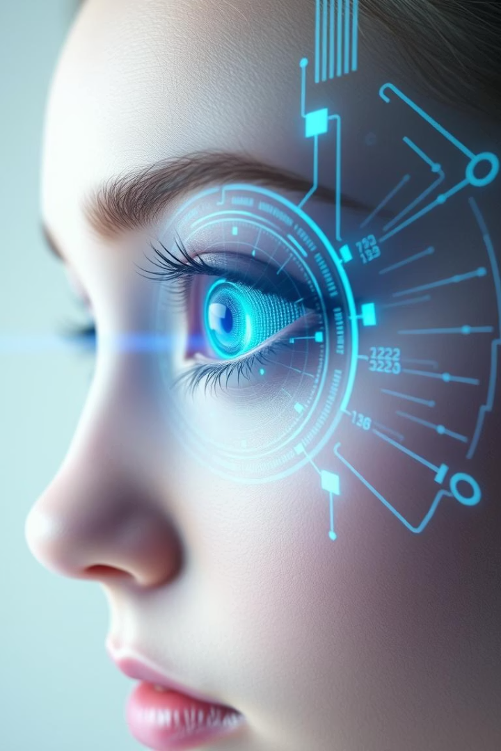
Face Detection Model
Why Build This Model?
Ensure exam integrity in remote environments.
Detect and track examinee’s face in real-time.
Prevent cheating by identifying:
Multiple faces (unauthorized individuals).
Absence of examinee.
Suspicious behavior (head pose, gaze direction).
Use Case
Used as a core component in an online proctoring system.
Works with other models like:
Face recognition to verify the identity of the examinee in real-time.
Head pose estimation for detecting suspicious movements.
Gaze detection to monitor where the examinee is looking.
15

Slide 16
YOLOv8 for Face Detection: Why & How
Why Choose YOLOv8?
Dataset & Preprocessing
Faster and more accurate than YOLOv5, Faster R-CNN, and SSD on small, moving targets.
Dataset Overview
Source: WIDER FACE dataset
Real-time inference: 50+ FPS at 640×640 image size.
Total images: 32,203
Native support for fine-tuning and transfer learning.
Annotated faces: 393,703
Lightweight variant YOLOv8n balances speed and accuracy for live webcam use.
Features:
Diverse lighting, poses, occlusions, expressions, crowd density
Model | Accuracy | Speed | Suitability for Faces
YOLOv8 | High | Fast | Best overall
YOLOv5 | Good | Fast | Slightly lower performance
Faster R-CNN | Very high | Slow | Too slow for real-time
SSD | Moderate | Moderate | Lower accuracy for small faces
Label Format
YOLO format: class_id x_center y_center width height
All values normalized to [0,1] range
Image Processing
Resized to 640×640 pixels
Color space preserved as RGB
Data verified for integrity
Augmentations: flips, HSV shifts, scaling, rotation — added to improve model robustness to lighting, angles, and face positions.
16

Slide 17

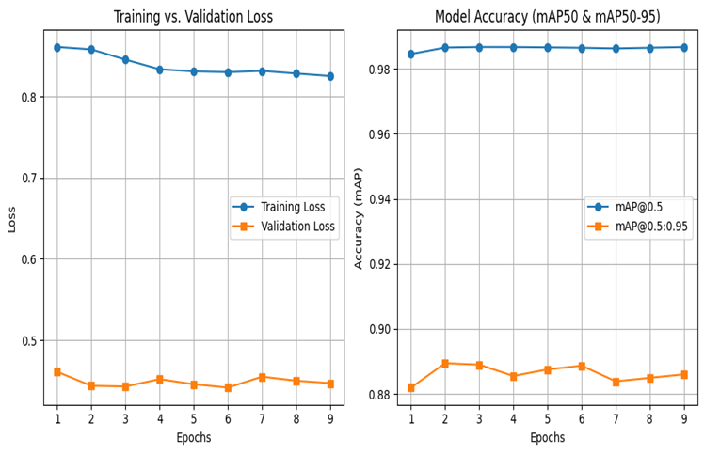
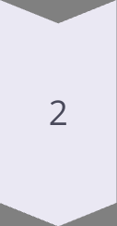
Training Process
Training Setup
Base model: yolov8n-face-lindevs.pt (pre-trained face-specific weights)
Framework: Ultralytics YOLOv8
Optimizer: SGD
Learning rate: 0.0001
Batch size: 16
Epochs: 40
Mixed precision: Enabled to reduce training time and memory use.
Key Training Features
Fine-tuning from pre-trained weights enabled fast convergence.
Early stopping used to prevent overfitting.
Mixed precision training for faster computation.
17

Slide 18
Training Results
Box Loss: 0.825
Class Loss: 0.050
Measures how well predicted bounding boxes match true face positions. Lower is better.
Measures classification error. Very low due to single-class task.
DFL Loss: 0.889
Refines bounding box prediction. Lower = better edge accuracy.
Validation Performance
Precision: 95.1%
Recall: 95%
95.1% of detected faces were actual faces. Few false positives.
95% of actual faces were detected. Few false negatives.
mAP@0.5: 98.7%
mAP@0.5–0.95: 88.6%
Model detects faces accurately when predicted boxes overlap ≥50% with ground-truth.
Measures accuracy across strict to lenient IoU thresholds. High score means strong, reliable detection.
18

Slide 19
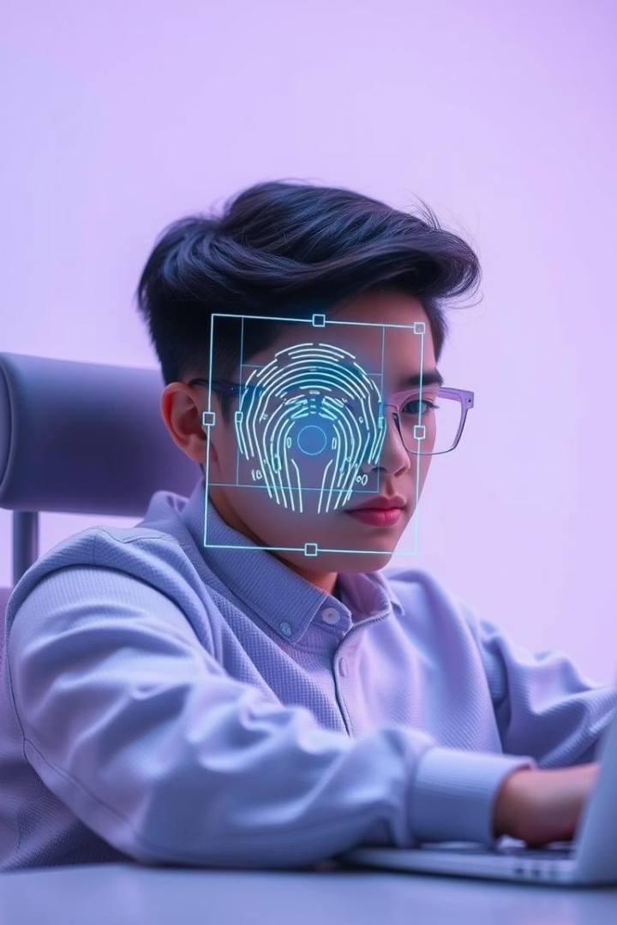
Face Recognition Model
Objective :
Ensure only the registered student takes the quiz.
Detect impersonation, unauthorized assistance, or multiple faces in the frame.
Key Technologies Used :
FaceNet : For high-accuracy face recognition.
YOLOv8 : For fast face detection.
MTCNN : For precise facial alignment.
FAISS & Cosine Similarity : For efficient identity matching.
Why Face Recognition Matters in Online Exams
Problem : Cheating via impersonation or external help.
Solution : Real-time face verification using AI.
Benefits :
Identity confirmation at exam start.
Multi-face monitoring.
Automated alerts for suspicious behavior.
19

Slide 20
Face Recognition Model – FaceNet
Overview :
Deep learning model developed by Google.
Converts facial images into 128-dimensional embeddings .
Key Features :
High accuracy under varying lighting, expressions, and angles.
Uses Triplet Loss for tight intra-class clustering and inter-class separation.
FaceNet Architecture
Backbone : Inception-ResNet-v1
Advantages :
Components :
Lightweight (128D embeddings)
Feature Extraction (Inception + ResNet blocks)
Fast comparison using FAISS and cosine similarity
2. Embedding Layer (128D output)
Pretrained on large datasets (VGGFace2, CASIA)
3. Triplet Loss Function
20

Slide 21





Dataset Overview & Data Augmentation Techniques
Combined Sources :
Data Augmentation
CASIA-WebFace
Applied to classes with <600 images :
~494K images of 10,575 identities
Random rotation (±10°)
VGG2
~3.3M images of 9,131 identities
Width/height shifts (±10%)
Final Dataset :
Brightness scaling (0.8–1.2)
Total Classes : 383 unique students
Images per Class : Balanced between 600–720
Shear (0.1), Zoom (0.1)
Total Images : 229,459 after augmentation
Horizontal flips
Result :
Balanced dataset improves model generalization
Dataset Splitting
Training Set : 80% (183,567 images)
Validation Set : 20% (45,892 images)
Method : Stratified sampling to preserve class distribution
21

Slide 22




Image Preprocessing
Pipeline Steps :
Purpose :
Normalize lighting conditions
Color Space Conversion
Align facial landmarks
BGR → RGB → LAB
Provide consistent input to FaceNet
CLAHE Contrast Enhancement
Face Detection & Alignment
using MTCNN
Standardized Output
160×160 RGB image
22

Slide 23
Identity Matching Strategy
Techniques Used :
Real-Time Face Recognition Workflow
Cosine Similarity : Compares angle between vectors
Step-by-step Process :
Threshold : > 0.7 considered a match
Webcam feed acquisition
FAISS Index : Enables sub-millisecond search across large databases
Top-K Voting : Aggregates top 3 matches to reduce noise
Face detection (YOLOv8)
Face alignment (MTCNN)
Lighting normalization (CLAHE)
Embedding generation (FaceNet)
Identity matching (FAISS + Cosine Similarity)
Decision engine & alert system
23

Slide 24
Performance Metrics
Metric | Result | Notes
Test Accuracy | 91.33% | Generalizes well
Speed | 25 ms/frame | ~40 FPS
Baseline (Standard FaceNet) | 89.1% | Our model outperforms
Strengths :
Hybrid YOLO-MTCNN alignment
FAISS-optimized search (<1ms)
Strong class separation (confirmed by t-SNE)
24

Slide 25
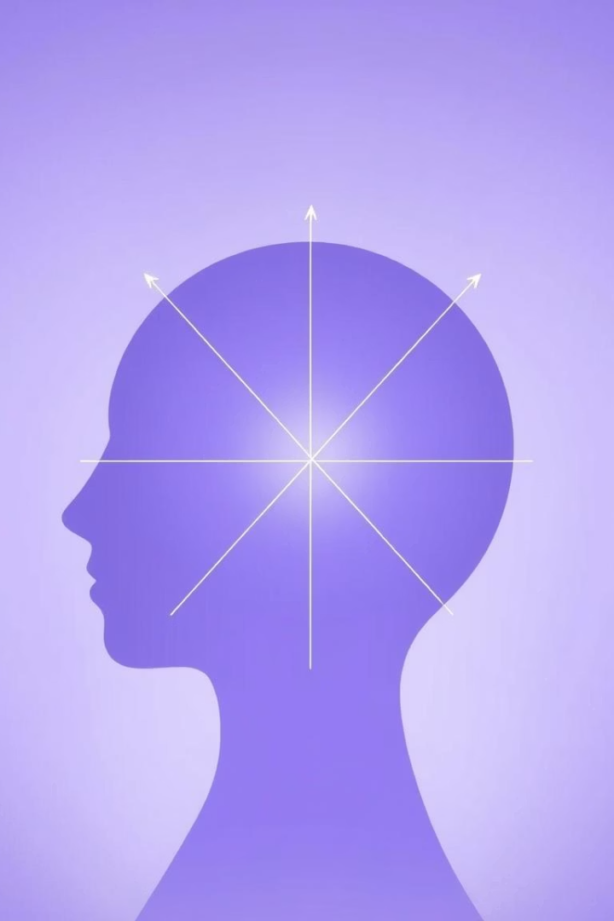

Head Pose Estimation Model
Why Build This Model?
Detect abnormal head movements during online exams.
Identify behaviors like frequent turning, tilting, or looking away.
Model | Accuracy | Speed | Real-Time Suitability
ResNet-18 | High | Fast | Best balance
ResNet-50 | Higher | Slower | Too slow
MobileNetV2 | Moderate | Fast | Lower accuracy
ResNet-18 pretrained on ImageNet for stable, efficient feature extraction.
Dual-task head for simultaneous angle regression and pose classification.
Fine-tunes faster than deeper models without major accuracy loss.
25

Slide 26
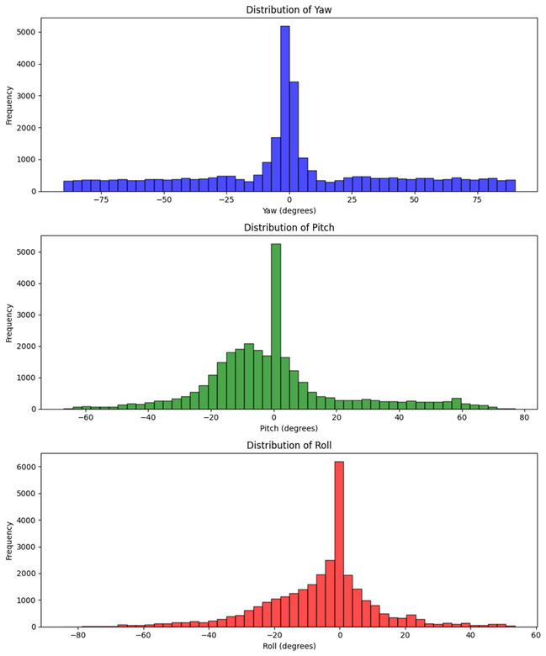
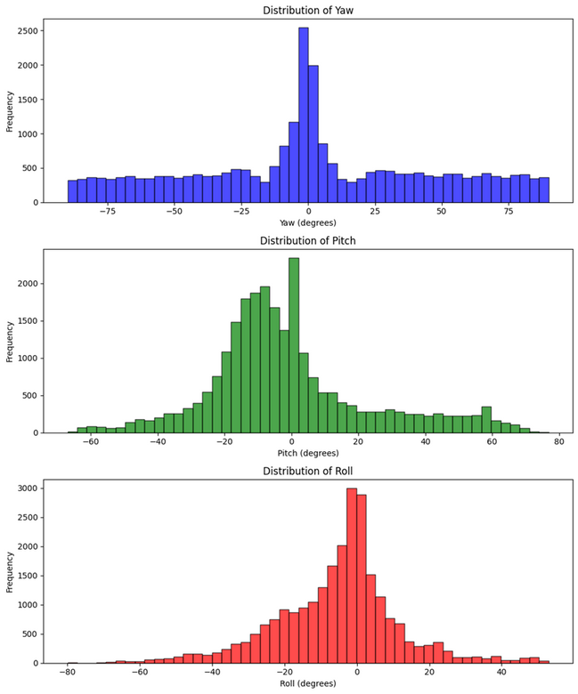
Dataset & Preprocessing
Sources: BIWI, 300W-LP, AFLW2000-3D
Images: 31,903
Angles Normalized:
Yaw: [−75°,75°], Pitch: [−60°,80°], Roll: [−80°,40°]
Processing
Detected faces cropped with YOLOv8.
Resized to 640×640.
Augmentations
Flips, HSV shifts, scaling, rotation, affine transforms.
Fix BIWI bias for neutral poses by:
Combine BIWI with rare poses from 300W-LP and AFLW2000-3D.
Under-sampling frontal (near 0°) poses to balance the dataset.
Weighted sampling during training to increase the presence of rare, extreme angles.
Dynamic loss weighting in the loss function to assign higher penalties for extreme pose prediction errors.
BEFORE FIXING THE BIAS
AFTER FIXING THE BIAS
Augmentations: Affine transforms, flips, and rotations to artificially increase data diversity for uncommon angles.
26

Slide 27
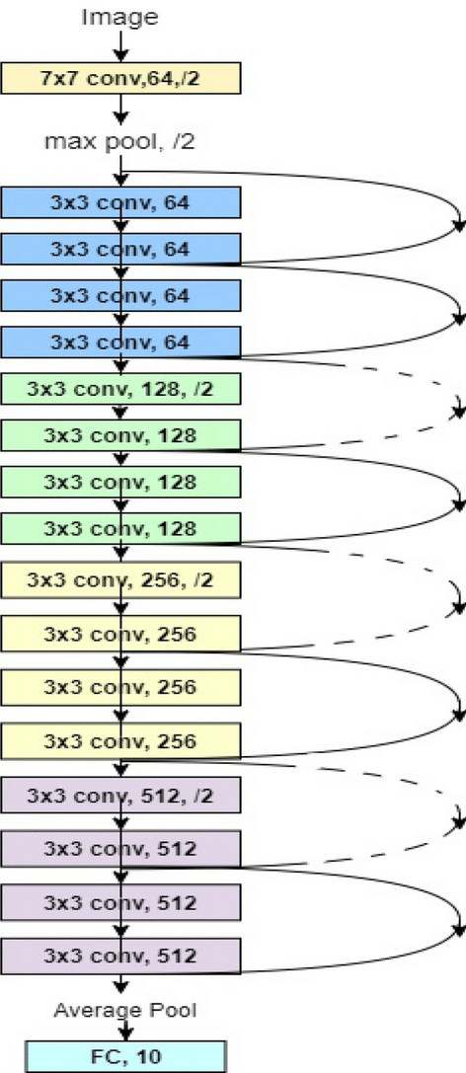
Model Architecture
Base model: ResNet-18 (pre-trained on ImageNet)
Lower layers frozen.
Modified for regression:
Output layer regresses yaw, pitch, and roll angles.
Pose classification head:
Classifies pose into categories: frontal, left, right, up, down.
The first model was designed for general-purpose training and performs well on frontal, left, and right head poses. It uses balanced sampling across pose categories and moderate data augmentation, resulting in stable and lower loss.
The second model was specifically fine-tuned to improve estimation on extreme poses, particularly upward and downward angles. It applies hard undersampling for common poses and retains all samples for rare ones, with stronger data augmentation. This model shows higher loss, reflecting the increased difficulty and imbalance of the targeted poses.
27

Slide 28
Training Process
Training Setup
Test Performance Summary
Framework: PyTorch
Optimizer: AdamW
Learning rates: 5e-6 (backbone), 5e-5 (heads)
Batch size: 32
Epochs: 25
Loss: MSE for angles + Cross-Entropy for pose class
Mixed precision: Enabled
Weighted sampling and dynamic loss weighting for rare poses
MSE (Yaw): 1.7°
MSE (Pitch): 1.5°
MSE (Roll): 1.9°
Pose classification accuracy: 94.3%
Inference speed: 24 ms/image
28

Slide 29
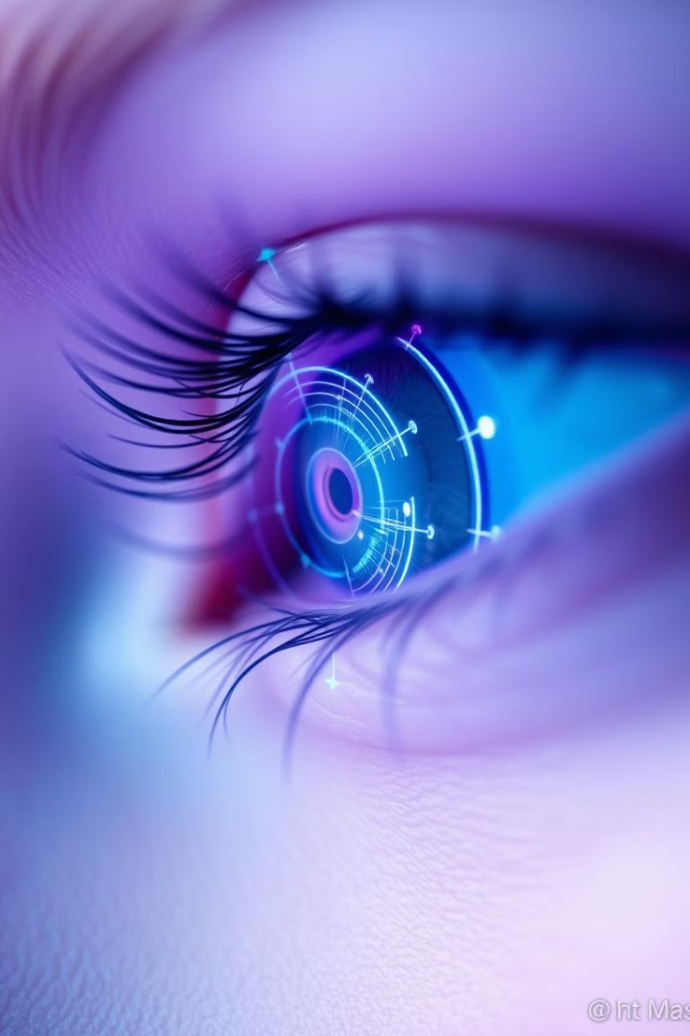
Gaze Pose Estimation Model
Why Build This Model?
Detect eye movements that may indicate cheating.
Monitor if the examinee is:
Looking at unauthorized devices or materials.
Frequently glancing away from the screen.
Provide non-intrusive, automated surveillance.
29

Slide 30
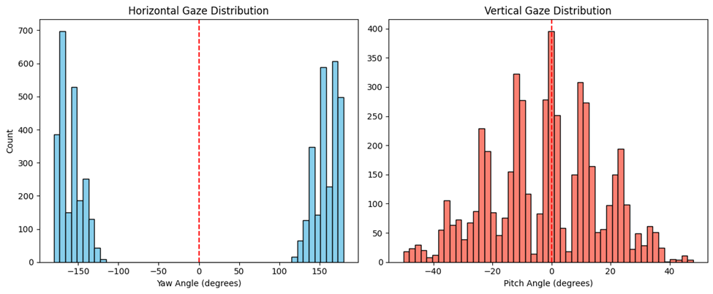
Dataset & Preprocessing
Source
Fix gaze dataset bias for underrepresented directions by:
SynthEyes synthetic dataset
Add targeted augmentations: flips, brightness shifts, noise, and small rotations to increase rare gaze samples.
Samples
11,382
Use adaptive loss with dynamic weighting to upweight peripheral (|yaw| > 30°) and upward (pitch > 15°) gazes during training.
Yaw range
Freeze early ResNet layers, fine-tune deeper layers for better adaptation to diverse gaze directions.
±180°
Pitch range
Lower learning rate and dropout to stabilize training with augmented, imbalanced data.
Increase early stopping patience to give the model time to learn from rare, augmented samples.
±50°
Processing
Resized to 224×224
Normalized using ImageNet stats
Augmentations
Flips, rotations, noise, brightness, and contrast jitter
30

Slide 31
Model Architecture
Model B significantly improves upon Model A, reducing angular error by 70% (from 26.53° to 5.06°) through data augmentation for enhanced robustness. Key improvements include replacing the final layer activation with Tanh for gaze vector normalization and implementing adaptive cosine loss with dynamic weighting to correct directional bias, particularly for peripheral and upward gazes.
Feature | Model A | Model B
Base Model | ResNet-18 pretrained on ImageNet | Same
Frozen Layers | All except last 2 residual blocks | First 30 parameters (~first 4 layers)
Unfrozen Layers | Last two residual blocks (layer3, layer4) | From layer 5 onward
Final FC Layer | Custom head with dropout and linear layers | Same but with Tanh() activation
Loss Function | Dynamic weighted MSE loss | Adaptive cosine loss with dynamic weighting
Data Augmentation | No | Yes (flip, brightness, noise, rotation)
Learning Rate | 0.001 | 0.0005
Dropout Rate | 0.5 | 0.3
Early Stopping | 5 | 7
Patience Optimizer | Adam | Adam
Activation Output | None | Tanh()
31

Slide 32
The role of MediaPipe
MediaPipe Face Mesh accurately identifies eye landmarks (16 per eye), even with head movement.
Using these landmarks, you can:
Crop out each eye region from the full-face image.
Align and resize the eye image to match your model's input size (e.g., 224x224).
MediaPipe lets you preprocess real-world data (full images) to match what your model expects.
It’s fast, runs in real-time, and works well even with head movement or poor lighting.
32

Slide 33
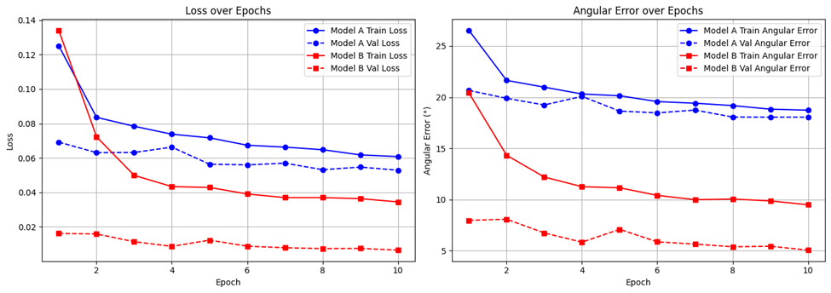
Training Process
Training Setup
Test Performance Summary
Framework: PyTorch
Best angular error: 5.06°
Optimizer: Adam
Validation loss: 0.0065
Learning rate: 0.0005
Inference speed: 24 ms/image
Batch size: 64
Reduced overfitting through heavy augmentation
Epochs: 26
Accurate gaze estimation even under head tilt and lighting variation
Loss: Adaptive Cosine Similarity Loss
Dynamic weighting: for peripheral and upward gazes
Mixed precision: Enabled
33

Slide 34
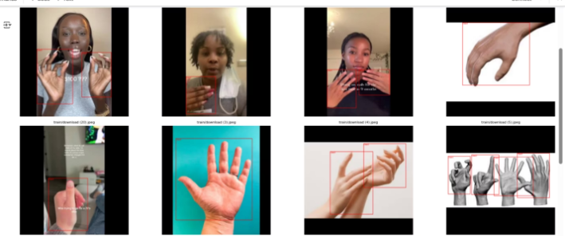
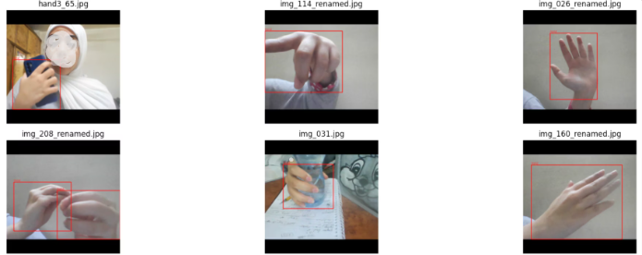
Object Detection Model
Data Overview & Collection Process
A) Data Collection Sources
Roboflow Datasets
Pre-labeled datasets from Roboflow Universe used as a foundational training corpus
Included annotated images of cheating-related objects such as:(Phones, Headphones, paper)
Web Images
Publicly available images of cheating-associated objects downloaded from the internet
Objects include:
Electronic devices (smartphones, laptops)
Written materials (notes, books)
Hand gestures
Webcam Captures
Simulated cheating scenarios recorded via webcam
Designed to capture real-world conditions including:
Varied lighting
Different postures and angles
34

Slide 35
Data labeling & Preprocessing
B) Labeling process
D) Label & Image Format
Manual Annotation tool : makesense.ai (for the captured, web images)
Label Format:
Prelabeled dataset in yolov8 format
Yolo format: class_id x_center y_center width height
Labeled classes : 'phone' , 'laptop' , 'head phones' , 'hand' , 'paper'
Normalized values(range:0-1)
Label Quality Assurance : Double-checked by human reviewer, Ensure high accuracy and consistency across all data sources
Image Resolution:
Resized to standard input size: 640x640 pixels
Color Space:
C) Dataset Composition
RGB (no grayscale conversion applied)
Total Classes Detected: phone, laptop, headphones, hand, paper
Data Integrity Checks:
Total Instances: Training: 8,754 instances, Validation: 1,369 instances
Verified for missing or corrupt files
Class Distribution:
Ensured label-image alignment and bounding box validity
Class | Train Instances | Val Instances
Phone | 1,704 | 291
Laptop | 1,925 | 280
Headphones | 1,731 | 178
Hand | 1,732 | 270
Paper | 1,655 | 350
E) Augmentation
To improve the model's generalization, we used data augmentation to simulate realistic exam scenarios such as:
Varying lighting conditions
Small or partially hidden objects
Objects at different angles
35

Slide 36
Training Process Overview& Evaluation
Training Process
Evaluation
Base Model : YOLOv8s.pt (pretrained on COCO)
Overall Model Performance
Model Type : Fine-tuned YOLOv8s for cheating detection
Precision: 97.3%
Training Setup :
Recall: 94.7%
Framework : Ultralytics YOLOv8
mAP@0.5: 97.2%
Optimizer : AdamW with cosine learning rate decay
mAP@0.5:0.95: 85.1%
Learning Rate : 0.001 → 0.01
Inference Speed: 890 ms/image (CPU) / <50 ms/image (GPU)
Batch Size : 32
Class | Precision | Recall | mAP@0.5 | mAP@0.5:0.95
Phone | 98.6% | 97.8% | 98.8% | 88.8%
Laptop | 94.3% | 89.3% | 94.3% | 82.0%
Headphones | 97.0% | 92.2% | 96.4% | 83.1%
Hand | 98.5% | 98.5% | 99.1% | 83.5%
Paper | 98.1% | 95.4% | 97.6% | 88.1%
Epochs : 200 (with early stopping at 30)
Input Size : 640×640 pixels
Loss Function :
Bounding box: CIoU
Classification: BCEWithLogitsLoss
Objectness: DFL Loss
36

Slide 37
Challenges and Solutions
Robust Augmentation: Simulated lighting changes (hsv_v=0.4, hsv_s=0.7) and motion blur for webcam realism.
Varied Lighting & Webcam Quality
Inconsistent lighting and low-resolution cameras hinder object detection.
Small-Object Tuning: Reduced anchor sizes and enabled overlap_mask=True for occluded items.
Small/Partially Hidden Objects
Adaptive Thresholds: Dynamic confidence scoring (e.g., higher thresholds for hands to reduce false alarms).
Earbuds, notes, or phones often appear tiny or occluded (e.g., hidden under hands).
Shear/Rotation Augmentation: shear=2.0, degrees=15 to handle angled objects.
False Positives
Normal movements (e.g., adjusting glasses) mistaken for cheating.
Diverse Object Orientations
Devices held at angles or rotated.
37

Slide 38
Inside process_images: Core Cheating Detection Logic
🎯 Purpose
Detects cheating via webcam during online exams
Calculates cheating score from AI model results
🔁 Parallel Execution
Uses asyncio.gather for concurrent execution of:
run_face_detection
run_object_detection
run_gaze_detection
head_pose_tasks
📥 Inputs
image: PIL Image (RGB)
student_id, quiz_id: For session tracking
📤 Outputs
Dictionary containing:
Detections (faces, gaze, objects, poses)
score_increment
alerts (e.g., "Suspicious gaze detected")
38

Slide 39
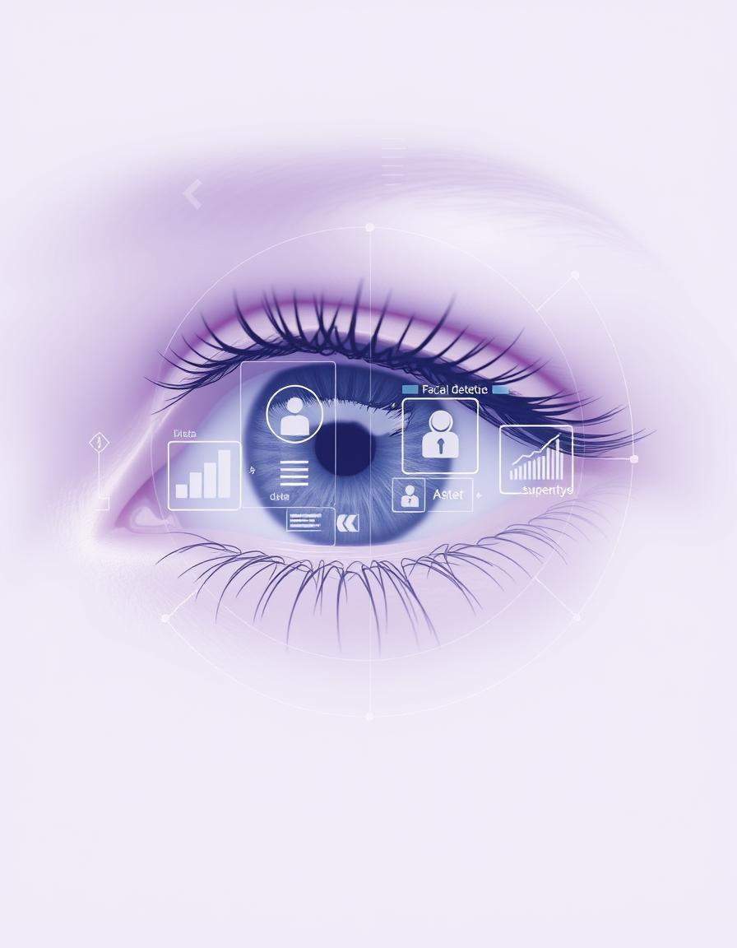
Cheating Detection Mechanism
+20 | Multiple Faces
+5 on 3rd detection | Non-Frontal Pose
+15 | Suspicious Object
+5 on 3rd detection | Suspicious Gaze
+10 | No Faces Detected
The /process_periodic endpoint combines model results. If the cheating score reaches 100, the quiz is auto-submitted. The system handles errors and uses a Kalman filter for gaze stabilization, ensuring robustness.
39

Slide 40
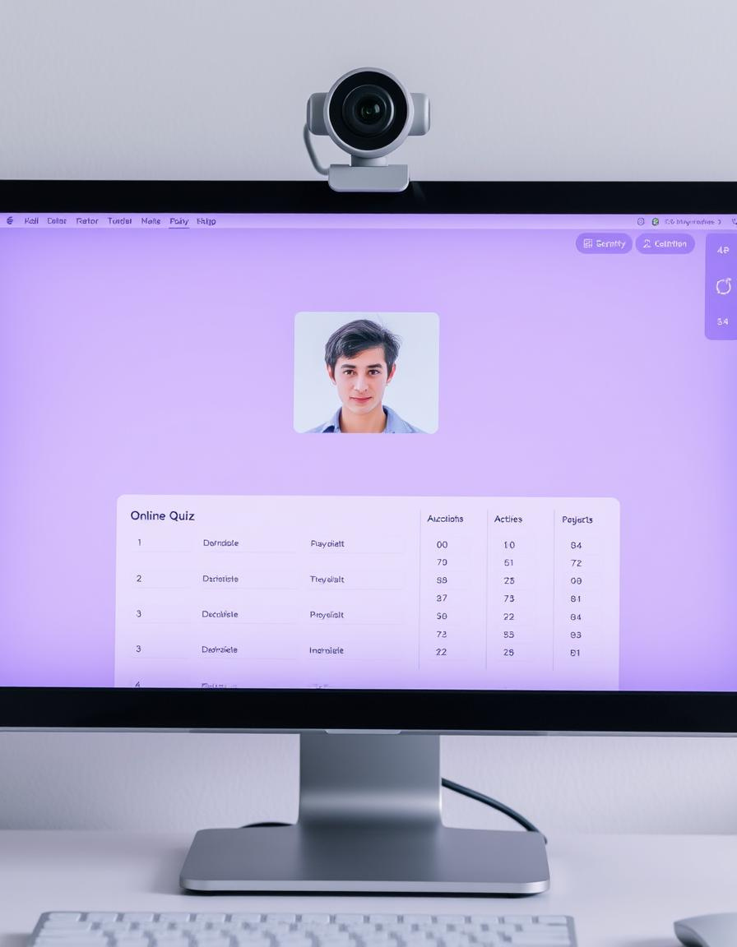



Front-End Integration with React
QuizInterface
Component
WebSocket Communication
Initializes webcam, captures frames, enforces fullscreen, disables copy/paste
Connects to FastAPI, displays real-time alerts as toast notifications
Key Actions
Sends images periodically, auto-submits quiz if score ≥ 100, navigates to results
40

Slide 41



User Registration Flow: Laravel & FastAPI Collaboration
User Registration (Laravel):
Facial Data Processing (FastAPI):
Outcome & Error Handling:
A user submits their registration details and captured images (minimum 3) to the Laravel backend.
Laravel validates the data and creates a new user record.
Laravel initiates a request to FastAPI, sending the user_id and the captured images.
FastAPI receives the user information and images.
It checks if the user_id exists.
For each image, FastAPI performs:
Success: FastAPI confirms successful image processing and embedding storage to Laravel. Laravel finalizes the registration.
Failure (FastAPI): If image processing fails or no valid faces are detected, FastAPI sends an error.
Rollback (Laravel): If FastAPI indicates an error, Laravel rolls back the user creation to maintain data consistency.
Decoding Base64 image data.
Facial alignment and detection.
Generation of facial embeddings.
These embeddings are then stored in FastAPI's database.
41

Slide 42
Deep Dive: Laravel & FastAPI for Quiz Integrity
Laravel Function: startQuiz
Orchestrates quiz start, verifies timing and completion status, and performs face verification via FastAPI before initializing a cheating score.
1
Laravel Endpoint: api/quizzes/update-cheating-score
Receives real-time cheating alerts and score increments from FastAPI, updating the database and logging alerts.
2
Laravel Function: submitQuiz
Calculates student scores, determines pass/fail, and retrieves the final cheating score for comprehensive result storage.
3
FastAPI Function: submit_to_laravel
Submits final quiz answers to Laravel, ensuring correct formatting for seamless processing.
4
42

Slide 43





System Impact
Enhanced Integrity
Detects multiple faces, suspicious objects, non-frontal poses, eye movement.
Empowered Professors
Auto-submit on cheating, detailed logs
Improved UX
Timers, progress bars, and question management
Scalable Design
Modular architecture for real-world deployment
43

Slide 44
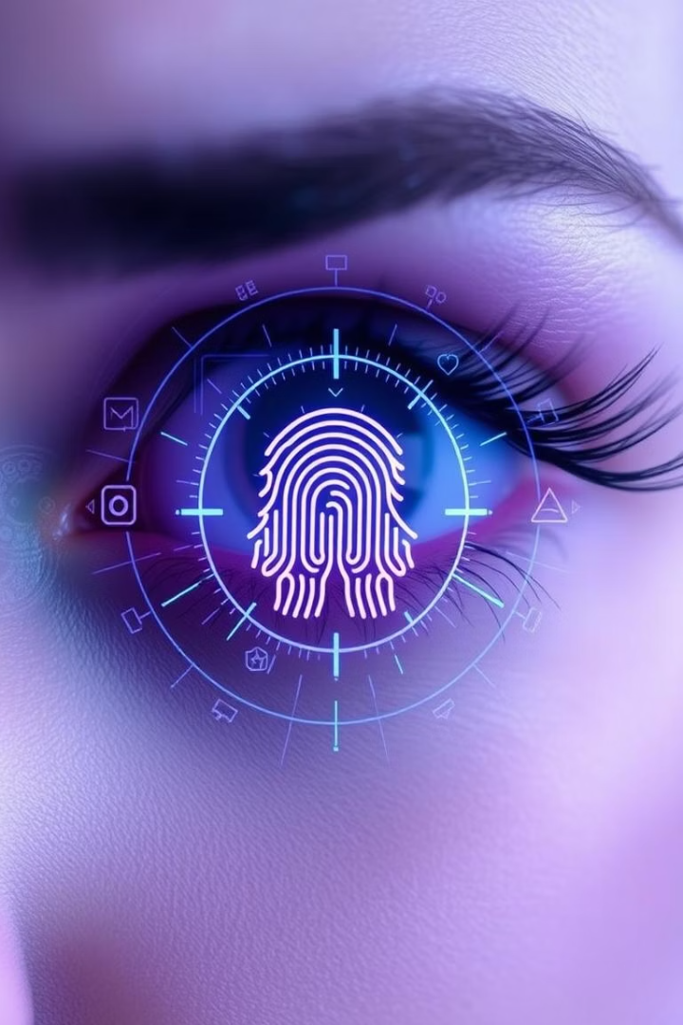




Future Enhancements
Anti-Spoofing & Edge Cases
Implement liveness detection and improve handling of partial occlusion and poor lighting conditions.
Behavioral AI & Cross-Model Validation
Utilize micro-expressions, lip tracking, and hand gestures. Combine gaze, head pose, and object detection to reduce false positives, e.g., ignoring gaze shifts if the head pose suggests looking at the keyboard.
Audio & Voice Integration
Sync with speech detection to flag off-topic conversations and add voice detection during quizzes.
Features Expansion
Expand datasets, conduct formal usability testing, and add multi-language support and analytics.
44

Slide 45





Conclusion
EduGuard provides a comprehensive solution to one of the biggest challenges in modern education: online cheating.
By integrating AI models (face recognition, gaze, head pose, and object detection), we ensure fair and secure online assessments.
The system combines learning and proctoring into one unified, user-friendly platform.
Our architecture is scalable, real-time, and designed with future expansion in mind.
EduGuard sets a new standard for smart e-learning in universities.
45

Slide 46

Thanks
Any questions?

